Slide 1


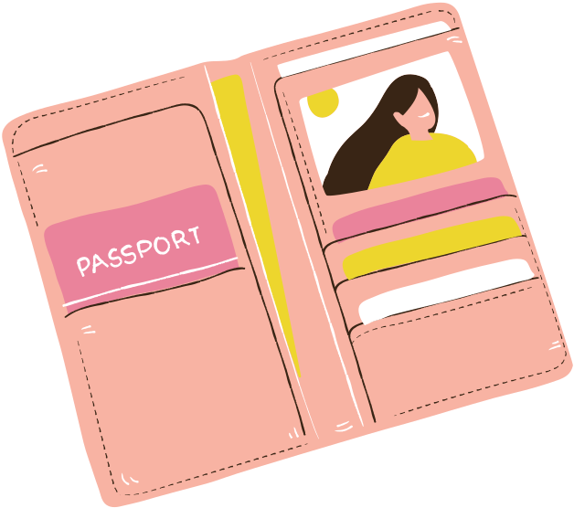


Chào mừng đến với phần trình bày của tổ 4

Slide 2
Chào mừng đến với phần trình bày của tổ 4

Slide 3


TOPIC OUTLINE
Travel Basics
Do's & Don'ts
Top Tourist Spots

Slide 4
TOPIC OUTLINE
Travel Basics
Do's & Don'ts

Slide 5
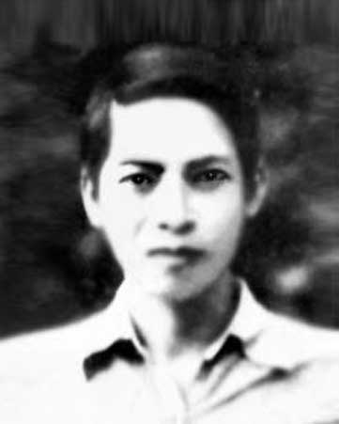
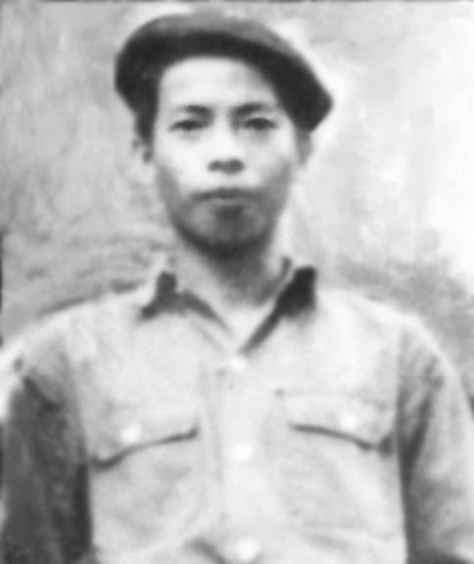

I.Giới thiệu về tác giả,tác phẩm

Slide 6
I.Giới thiệu về tác giả,tác phầm

Slide 7

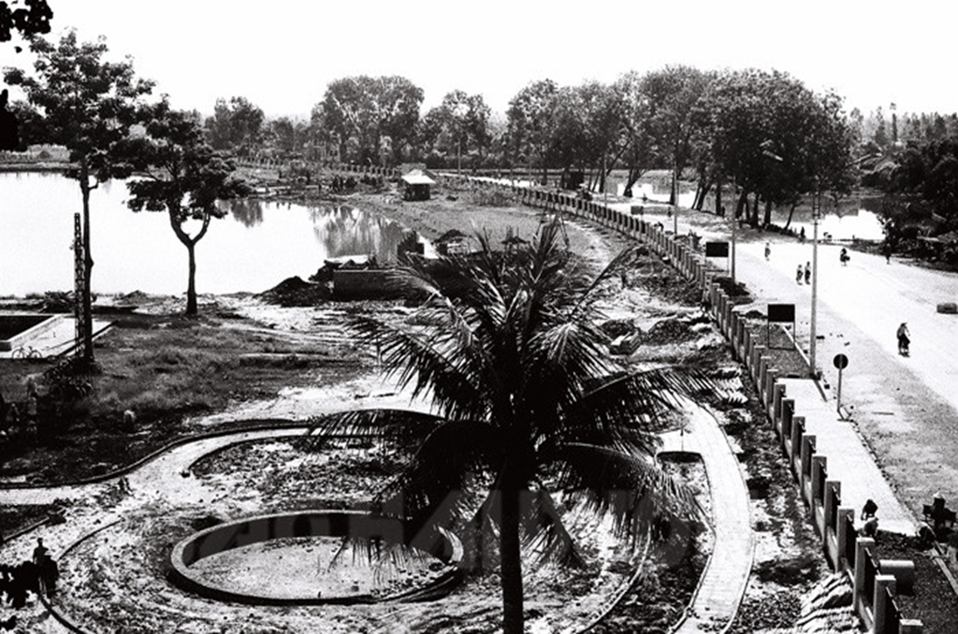
INTRODUCTION
World Travel Basics
Jumpstart your presentation by introducing the concepts and topics for the day.
Then, ask questions to interact with your audience.
Add a personal touch by customizing this layout as much as you want.

Slide 8
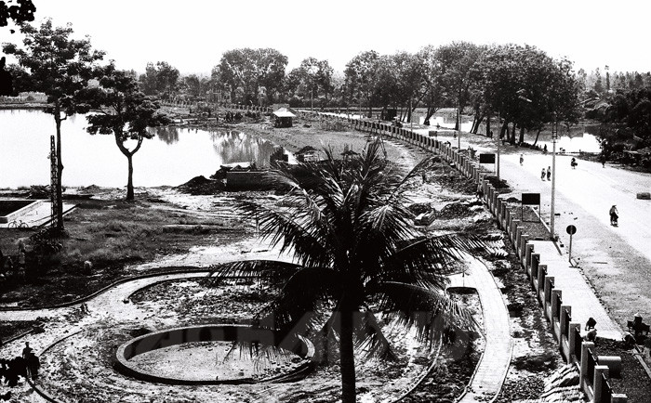
INTRODUCTION
World Travel Basics
Jumpstart your presentation by introducing the concepts and topics for the day.
Then, ask questions to interact with your audience.
Add a personal touch by customizing this layout as much as you want.

Slide 9
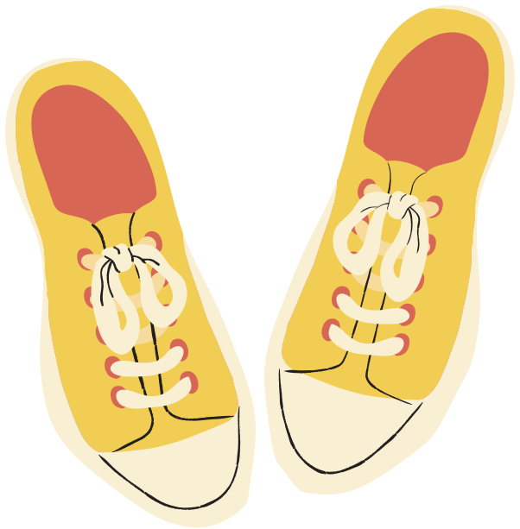

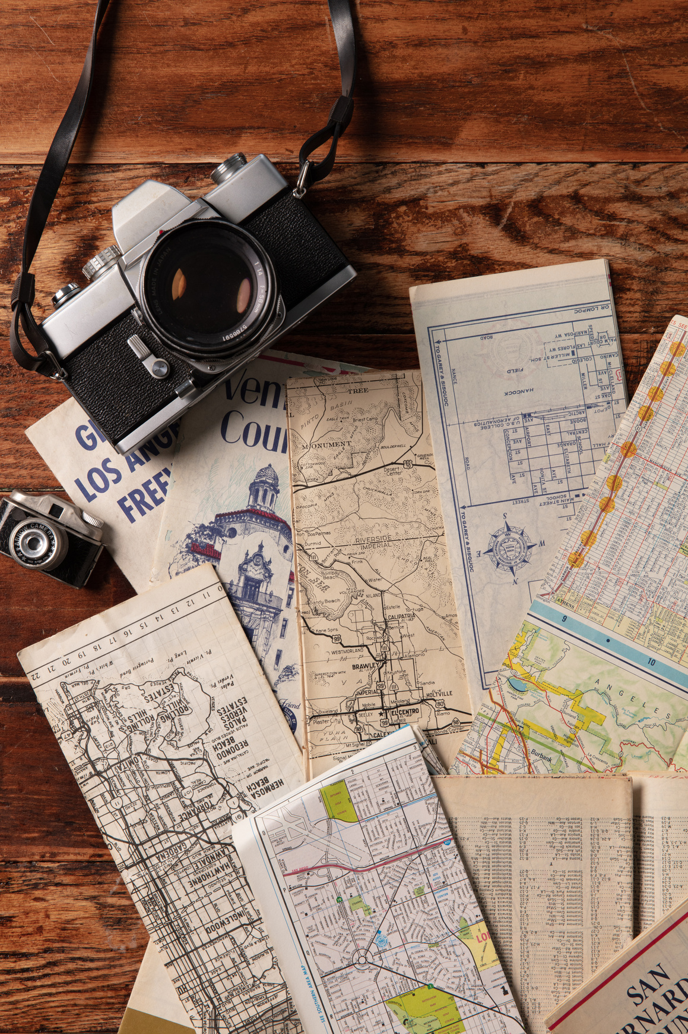
Tip No. 1
Tip No. 2
TRAVEL TIPS

Slide 10
Tip No. 1
Tip No. 2
TRAVEL TIPS

Slide 11
TRAVELING DO'S & DON'TS

Slide 13


IMPORTANT DO'S & DON'TS
YOUR DO'S & DON'TS HERE
YOUR DO'S & DON'TS HERE
YOUR DO'S & DON'TS HERE
YOUR DO'S & DON'TS HERE

Slide 14
IMPORTANT DO'S & DON'TS
YOUR DO'S & DON'TS HERE
YOUR DO'S & DON'TS HERE
YOUR DO'S & DON'TS HERE
YOUR DO'S & DON'TS HERE

Slide 15

TOP TOURIST SPOTS

Slide 16
TOP TOURIST SPOTS

Slide 17



TOP TOURIST SPOTS
Here's where you can start traveling:
Ask questions to interact with your audience. Add a personal touch by customizing this layout as much as you want.

Slide 18


